Slide 1
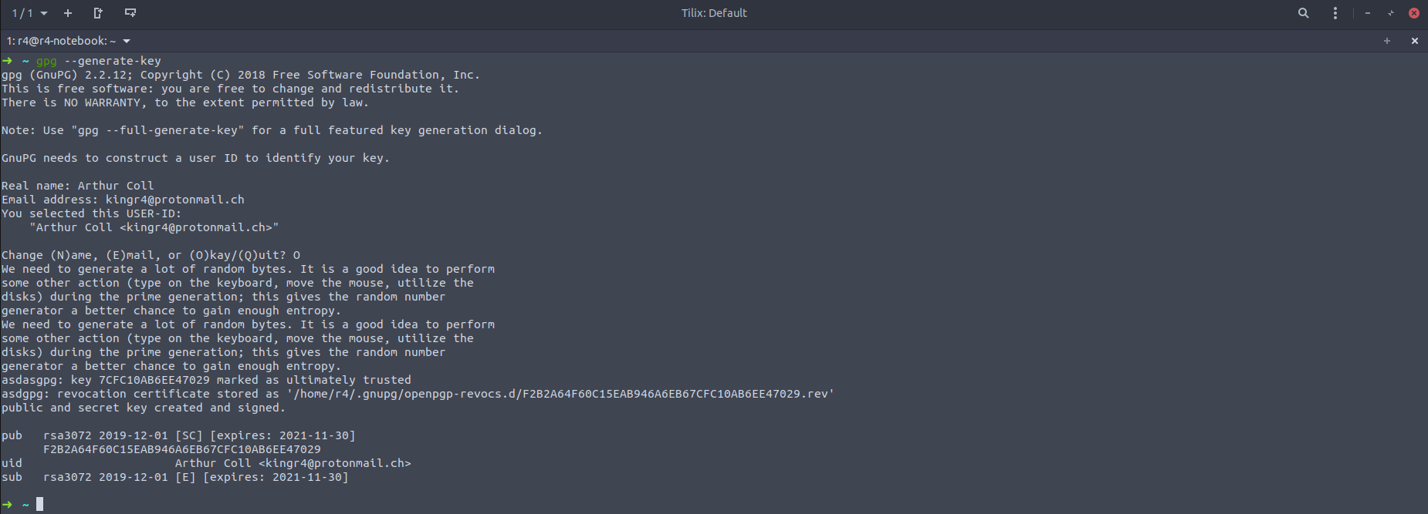
GPG
Generating a GPG Key Pair was easy on Linux, Ubuntu already comes with GNUPG preinstalled, so all I needed to do was run the gpg --generate-key command, enter my details and a password. The key was then automatically added to the key chain

Slide 2
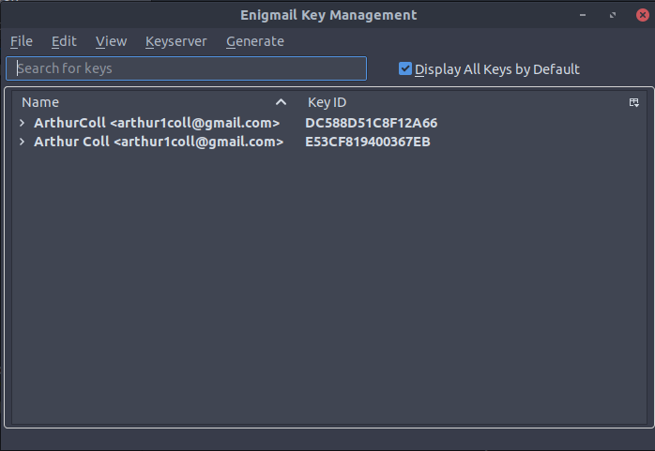
Enigmail
I already use thunderbird as a mail client, so all I needed to do was install Enigmail. This was easy with the extension store built in.
Since GNUPG already added the key to the keychain it appeared automatically in Enigmail and to use it all I needed to do was enter the password for the private key.
I then exported the public key and attached it to a plain text message for you.

Slide 3
NTP
Certificate based attacks, security certificates used for TLS are timestamped, spoofing the time allows attackers to use revoked or expired certificates on the victim. These are readily available on the web. Attacker may also be able to force a downgrade from TLS to Unencrypted communication in victim with insecure clients.
Authentication, Many authentication schemes used time stamped tokens, spoofing time allow attackers to increase their window of attack and make use of old leaked tokens.

Slide 4
NTP
DNSSEC, Secure DNS requires time stamped signed records. Spoofing time with NTP can allow the attacker to prevent the victim from resolving DNSSEC enabled domains and potentially to insert their own records.
NTP Amplification, Attacks can spoof packets with a victims IP address to NTP servers. These packets are designed to produce responses much larger than the packet and when they are sent back can overwhelm the victim, “Amplifying” the attack.

Slide 5
RSA
RSA is an asymmetric encryption algorithm, which means it uses a pair of keys one public one private. Only someone with possession the private key can decrypt something encrypted with the public key.
It’s based on the fact that it’s hard to factor large prime numbers, keys are generated as the result of two numbers being multiplied together, combined with entropy. Meaning if someone can factorize the number they will be able to break the keys.

